Slide 1

Myers-Briggs Personality Prediction
Sujata Gorai (HC6837 )
Nalisha Rathod (GS9440)

Slide 2
Agenda
Introduction
Related Works
Dataset
Methodology
Experiments and Results
Conclusion

Slide 3
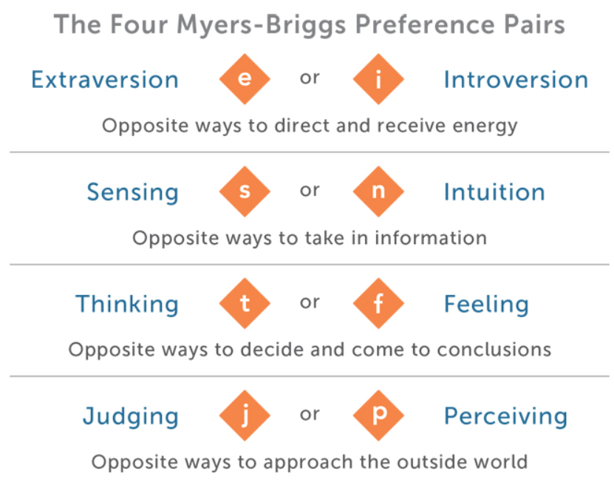
Introduction
MBTI is a personality metric developed by Katharine Cook Briggs and Isabel Briggs Myers
Each person would be typed with 4 letters according to MBTI.
For someone whose type is ENFJ, this means that this person is Extraverted, Intuitive, Feeling and Judging. All combination of these 4 letters gives us 16 unique personalities.
Common way of finding out MBTI type is through personality test websites. Sometimes the answers are biased and thus the person is wrongly classified.
Our project will try to find out the MBTI types for a person through their posts

Slide 4
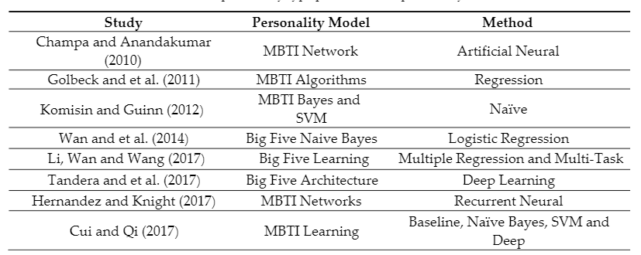
Related Work

Slide 5
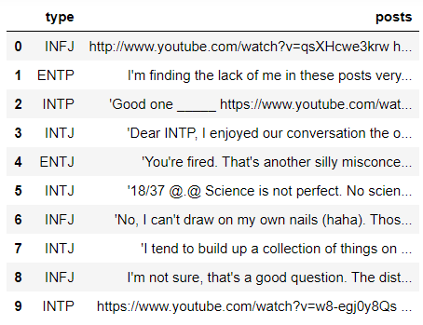
About the Data set
The Myers Briggs Type Indicator is a personality type system that divides everyone into 16 distinct personality.
The data is forum posts, originally from personalitycafe.com. The dataset is available in Kaggle - https://www.kaggle.com/datasnaek/mbti-type
The dataset has 8675 data. It only has 2 columns MBTI Types and Posts
Types – Class or type of MBTI personality – e.g. INFP, INFJ, ENTP,ESTJ etc.
There are 50 different posts from a single person all separated by ||| (3 pipe characters). Posts consist of Texts as well ad URL , emoticons, hashtags(#) and Mentions (@)
Above are the first 10 rows of data with Personality types and Posts

Slide 6
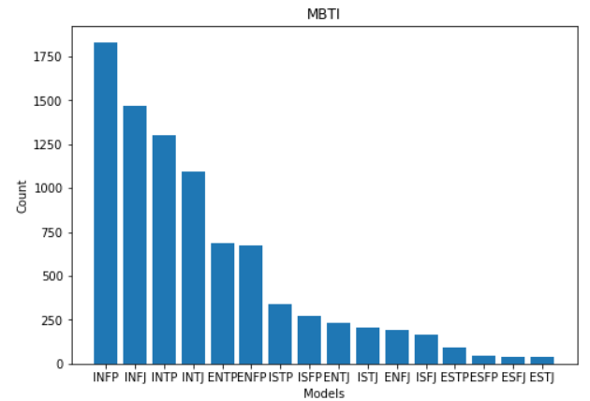
Dataset
The data is highly imbalanced – INFP has more than 1750 data but ESTJ has only 39.

Slide 7
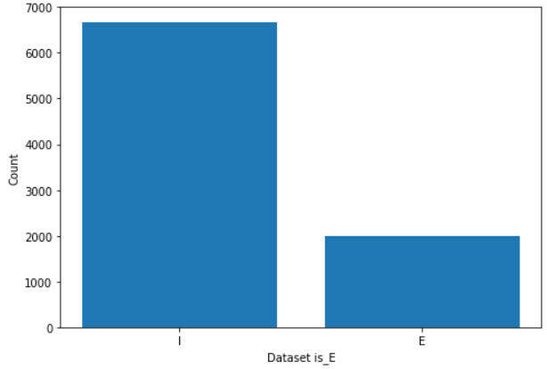
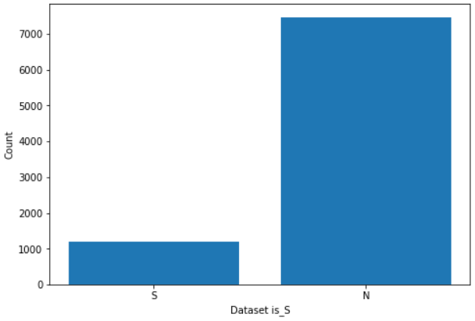
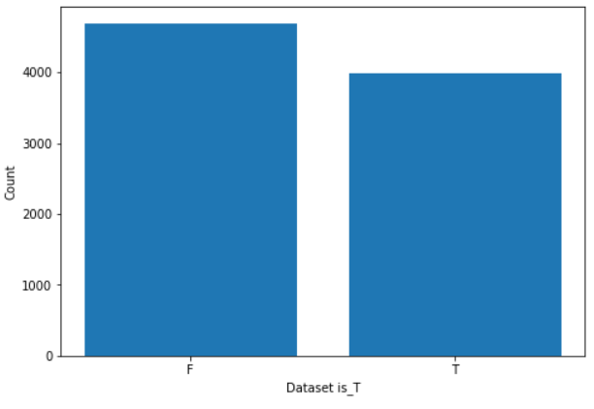
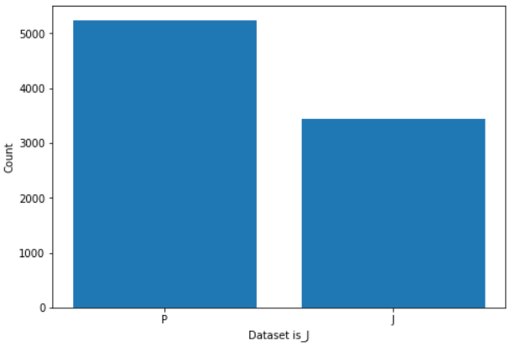
Data Preprocessing
As the data is imbalanced, we decided to reclassify the data into 4 Major personality types instead of 16:
Extraversion/Introversion as is_E Class
Sensing/Intuition as is_S Class
Thinking/Feeling as is_T Class
Judging/Perceiving as is_J Class
Each of them will have the same number of data i.e. 8675
For E.g. if the personality type was ISFJ we re-classify it for the 4 different personality dataset as :
I will be assigned to dataset is_E and Class as 0
S will be assigned to dataset is_S and Class as 1
F will be assigned to dataset is_T and Class as 0
J will be assigned to dataset is_J and Class as 1
There is still imbalance in the data mainly for is_E and is_S . But the is_T and is_J is almost balanced.

Slide 8
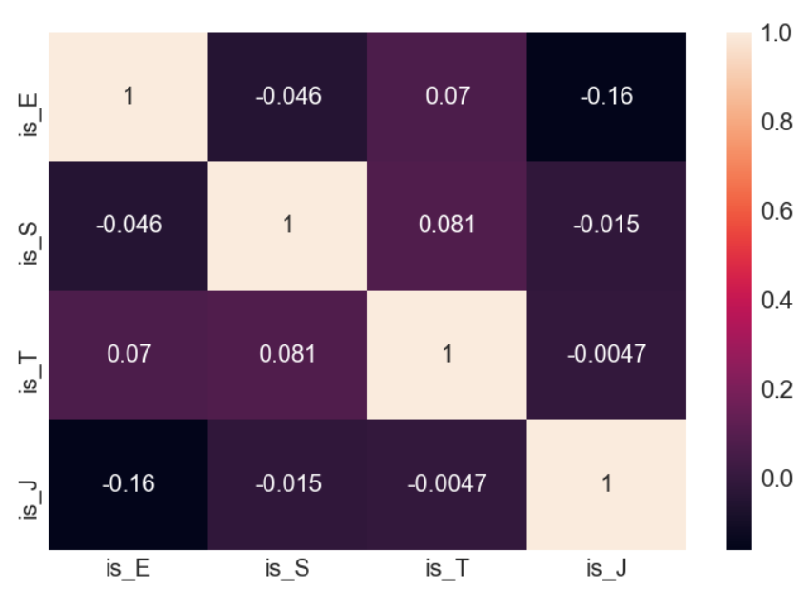
Data Preprocessing
This is the correlation plot for the 4 new personality types
As we can observe that most of the values are very low and close to 0. So, we can confirm that the 4 are not highly correlated and independent of each other.
We would be testing the difference in behavior of the balanced and the unbalanced class.
Is_E is selected form the unbalanced class
Is_T is selected from the balanced class

Slide 9
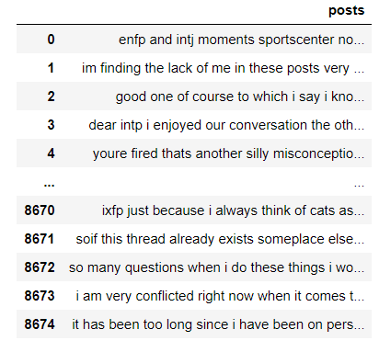
Data Preprocessing
Cleaning the data – Posts
Remove the URL, Hashtags, Emoticons, words containing numbers and Mentions
Made the text into lowercase
Remove punctuations
Remove Stop word – added the MBTI types that are mentioned
Divided the Data into 3 parts Train, Validate and Test
Separated the Posts and Type into X data and Y label
Tokenized the data
Vectorization – Word Embeddings
Word2Vec
GloVe
FastText

Slide 10

Machine Learning Models
Support Vector Machine
Logistic Regression
XGBoost

Slide 11
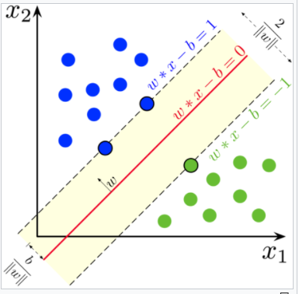
Support Vector Machine
A support vector machine (SVM) is a supervised machine learning model that uses classification algorithms for two-group classification problems.
Implementation:
Normalized word embeddings for each sentence in the vectorized training dataset was fed as input into the SGDClassifier model
Optimizer - Stochastic Gradient Descent
Class weight - balanced
Loss - hinge
5-fold cross-validation technique was used to determine the training accuracy score.

Slide 12
Logistic regression is a classification algorithm used to solve binary classification problems. The classifier uses the weighted combination of the input features and passes them through a sigmoid function. Sigmoid function transforms any real number input, to a number between 0 and 1.
Implementation:
The normalized word embeddings for each sentence in the vectorized training dataset was fed as input into the LogisticRegression classification model
Optimizer - Stochastic Average Gradient descent(sag)
Class weight as ‘balanced’.
5-fold cross-validation technique was used to determine the training accuracy score.
Logistic Regression

Slide 13
XGBoost - eXtreme Gradient Boosting
XGBoost (XGB) stands for eXtreme Gradient Boosting and is an implementation of gradient boosting machines that pushes the limits of computing power for boosted trees algorithms as it was built and developed for the sole purpose of model performance and
computational speed.
Implementation:
Created a python function for XGBoost
‘booster’ is set to gbtree
‘eta’ or the learning rate is set to 0.1.
’max depth’ is set to 6
‘min child weight’ is set to 1
‘subsample’ (subsample ratio of the training instances) is set to 0.7
‘colsample bytree’ (subsample ratio of columns when constructing each tree) is
set to 0.7
’objective’ (learning objective) is set to binary: logistic
Number of rounds as 500
Early stopping as 20

Slide 14
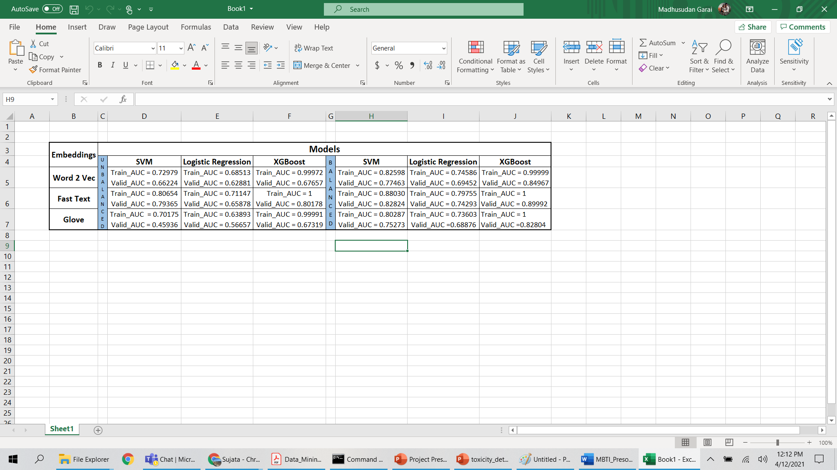
Results with Machine Learning Models

Slide 15
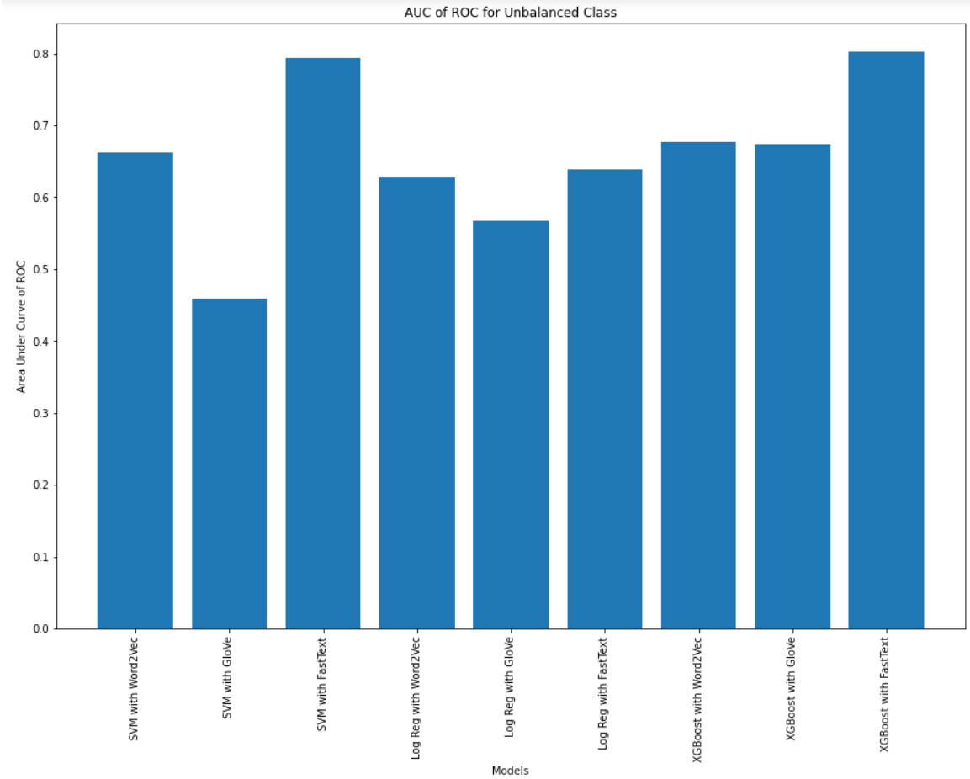
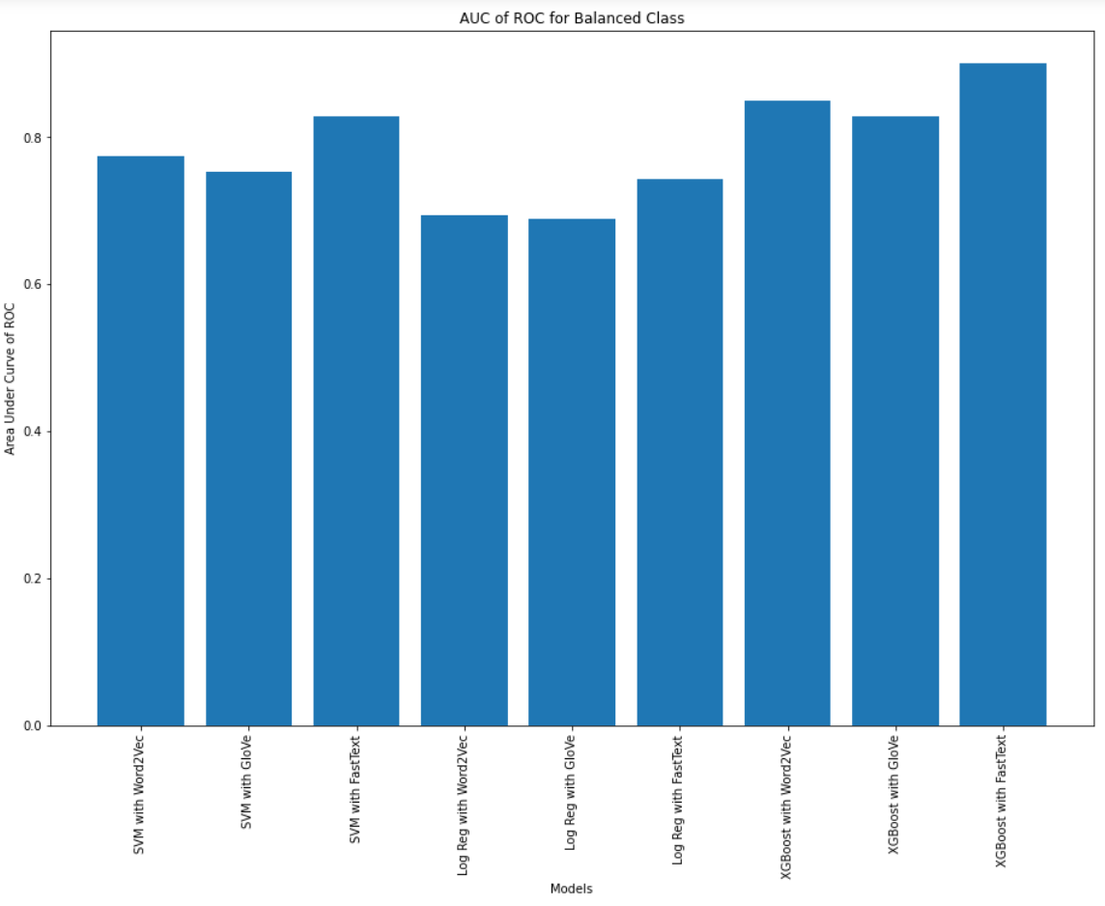
Visualizing the Results

Slide 16

Deep Learning Models
We have used three deep neural network models to perform our tasks.
The models are :
1) Long Short-Term Memory (LSTM) with Dropout
2) Bidirectional Gated Recurrent Unit(GRU)
3) Pooled Gated Recurrent Unit(GRU)

Slide 17
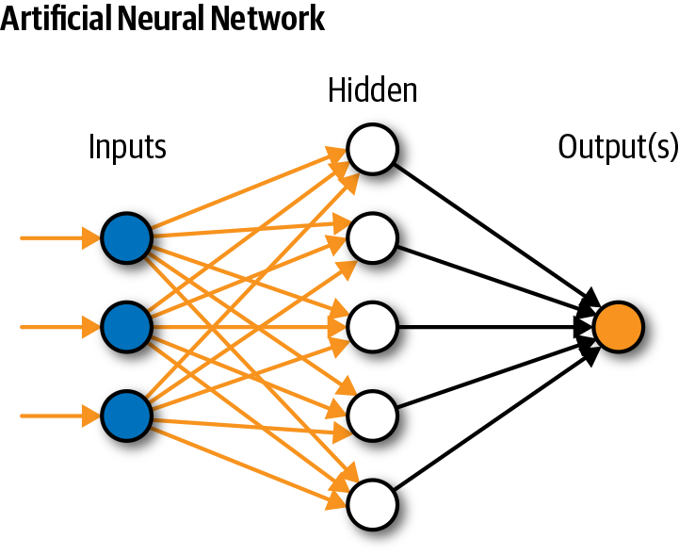
What is Deep Learning ?
Deep learning is subset of Machine Learning.
Structure inspired by human brain.
It is used in Natural Language Processing, Visual Recognition, Fraud Detection.
It describes certain types of Neural networks.

Slide 18
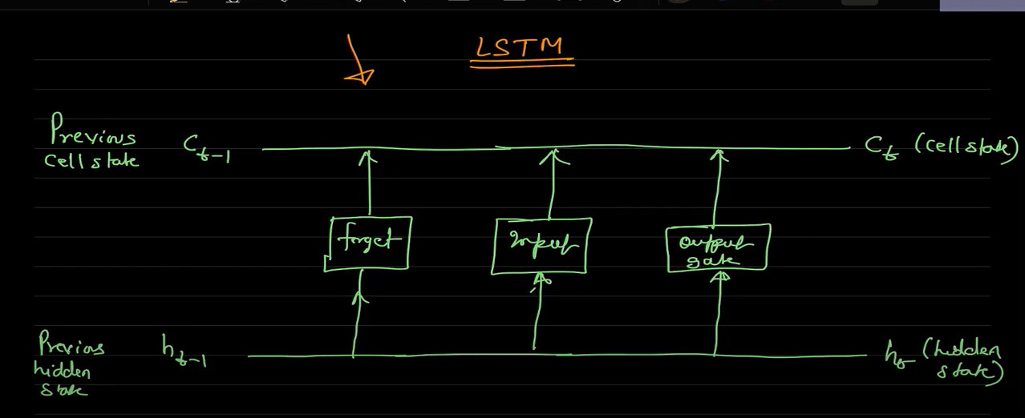
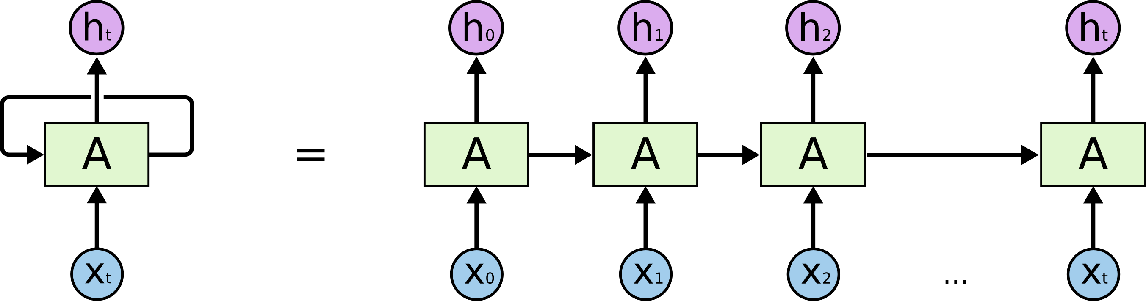
LSTM vs RNN
LSTM
RNN

Slide 19
Long Short-Term Memory (LSTM)
To reduce the problem with long term dependencies in Recurrent Neural Network (RNN).
Drawbacks of RNN
For example : 1) The sky is _______ (this can we predicted by RNN)
2) Recurrent neural networks (RNN) are the state-of-the-art algorithm for sequential data and are used by Apple’s _________(this cannot be predicted by RNN)
LSTM consists of 3 units: Input Gate, Forget Gate and Output Gate.

Slide 20
LSTM Processing
glove.840B.300d for word embedding in this model
dropout layer - reduce the overfitting problem
Parameters used are
-embed size = 50 ( how big is each word vector) -max features = 20000 (how many unique words to use) (i.e num rows in embedding vector) -maxlen = 100
Prepossessed the data with padding and tokenization
We have used loss=‘binary crossentropy’ optimizer=‘adam’ metrics=[‘accuracy’].

Slide 21
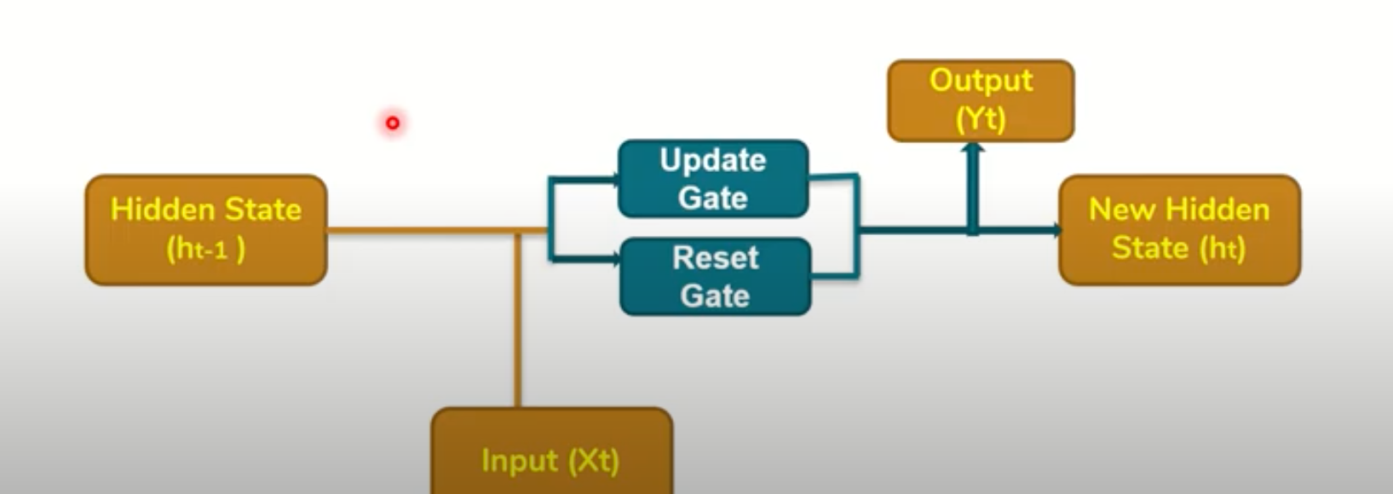
Bidirectional Gated Recurrent Unit (GRU)
GRU’s are a modifications to RNN.
It utilizes the Gate mechanism same as LTSM to manage and control the flow of information between the cells in the NN.
It has two gates Update gate and Reset Gate

Slide 22
Bidirectional GRU Processing
glove.840B.300d for word embedding in this model
dropout layer - reduce the overfitting problem
Parameters used are
max features=100000 (maximumfeatures)
maxlen=150 (maximum length) embed size=300 (size of embedding)
Prepossessed the data with padding and tokenization then convert it vector by using word embeddings.
Set two pooling layers (average pooling and max pooling) layer after bidirectional GRU layer
set dense layer
batch size = 32 and number of epochs = 2
We have used loss=‘binary crossentropy’ optimizer=‘adam’ metrics=[‘accuracy’].

Slide 23
Pooled Gated Recurrent Unit (GRU)
It is a simple GRU.
It has Pooling Layers- > Pooling Layers are used to reduce the dimensions of the feature matrix.
Therefore, it reduces the number of parameters to learn, and the amount of computation performed in the network.

Slide 24
Pooled GRU Processing
FastText 300d for word embedding in this model
dropout layer - reduce the overfitting problem
Parameters used are
max features=30000 (maximumfeatures)
maxlen=100 (maximum length) embed size=300 (size of embedding)
Prepossessed the data with padding and tokenization then convert it vector by using word embeddings.
Set two pooling layers (average pooling and max pooling) layer after bidirectional GRU layer
set dense layer
batch size = 32 and number of epochs = 2
We have used loss=‘binary crossentropy’ optimizer=‘adam’ metrics=[‘accuracy’].

Slide 25
Experiment with Deep Learning Models(is_T class- balanced)

Slide 26
is_S class- (imbalanced)

Slide 27
is_S class- (balanced)

Slide 28
Loss Calculation (is_T class)

Slide 29
Loss of is_S class (imbalanced)

Slide 30
is_S class (balanced)

Slide 31
Future Work
Apply various other classification model to this dataset and to the new domain of Data.
Trying to make the dataset balanced using different techniques.
Modify the preprocessing techniques .

Slide 32
Conclusion

